Slide 1
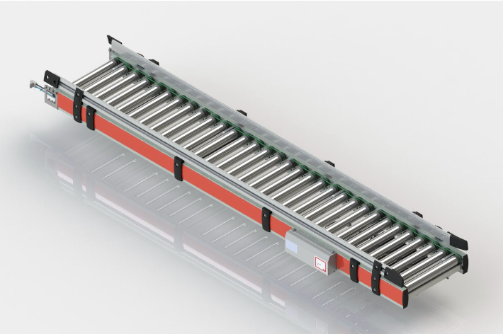
RAG Benchmark Challenges
Exemplified with the Technical Documentation of KRC KingDrive® Rollenförderer T

Slide 2
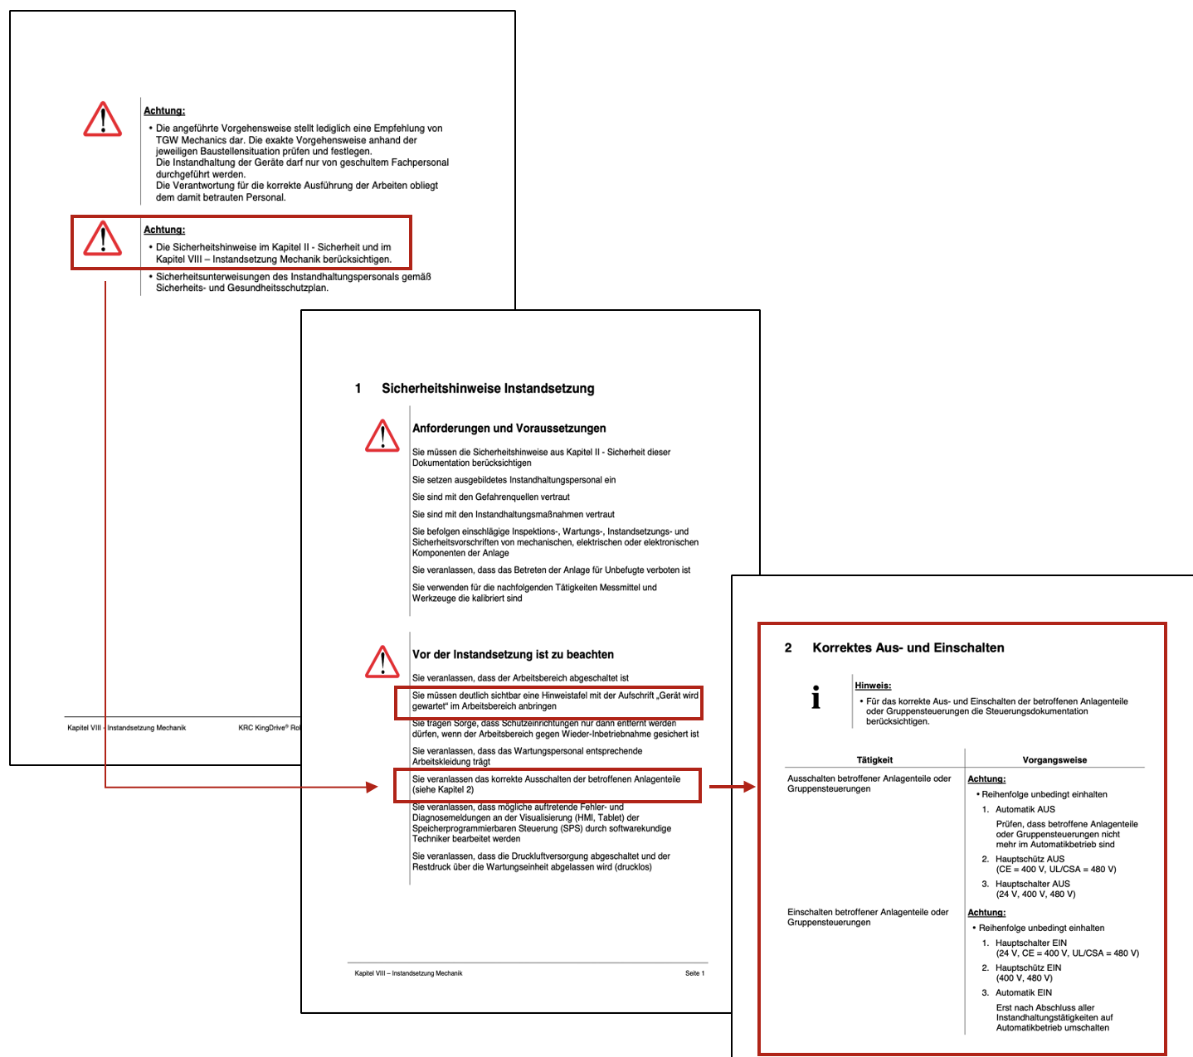
General Safety Instructions
01
Technical documentation often contains general safety instructions that apply to every machine modification.
Problem:
The relevant safety information is usually referenced only at the beginning of the document or located in a separate document → It will not get retrieved with RAG
Test Query:
- “Wie wechsele ich das Netzteil?”

Slide 3
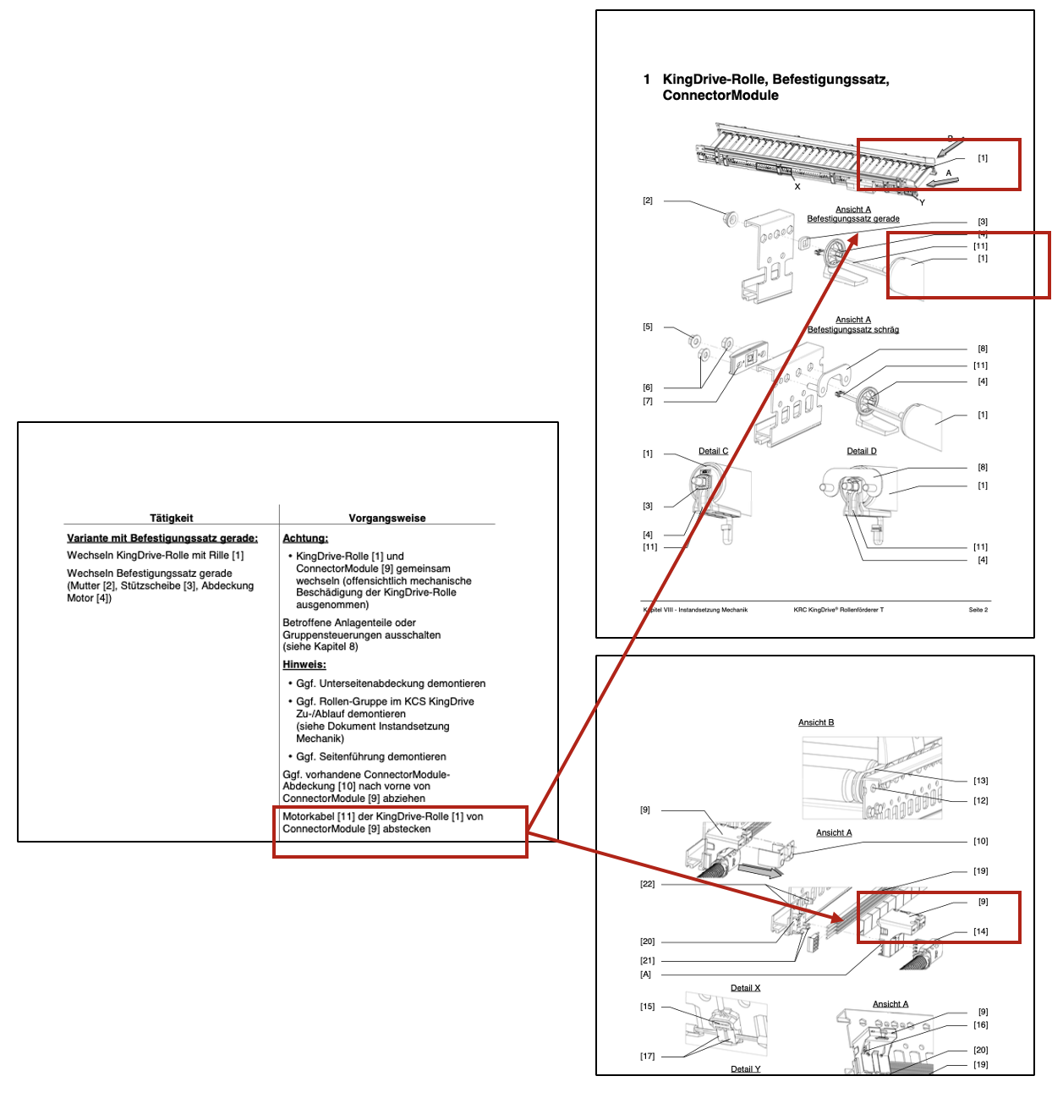
Diagram Reference
02
Instructions reference a visualization in a diagram located on another PDF page.
Problem:
A connection between the reference and the actual visualizations needs to be established → Non-trivial for complex diagrams
Test Query:
“Wie wechsele ich eine KingDrive-Rolle?”

Slide 4

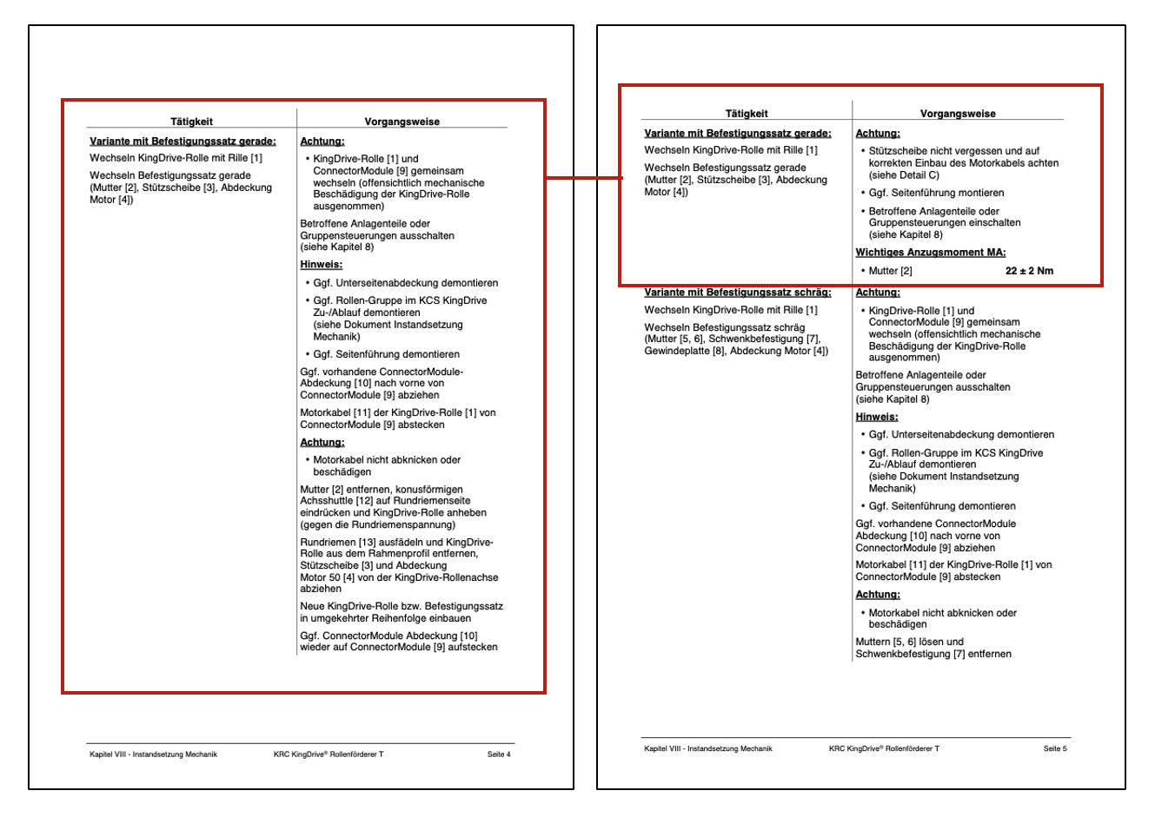
Long Tables
03
A single instruction in a table format might span several PDF pages.
Problem:
Sophisticated contextual understanding is required to identify interrelated text blocks
Test Query:
“Wie wechsele ich eine KingDrive-Rolle?”

Slide 5
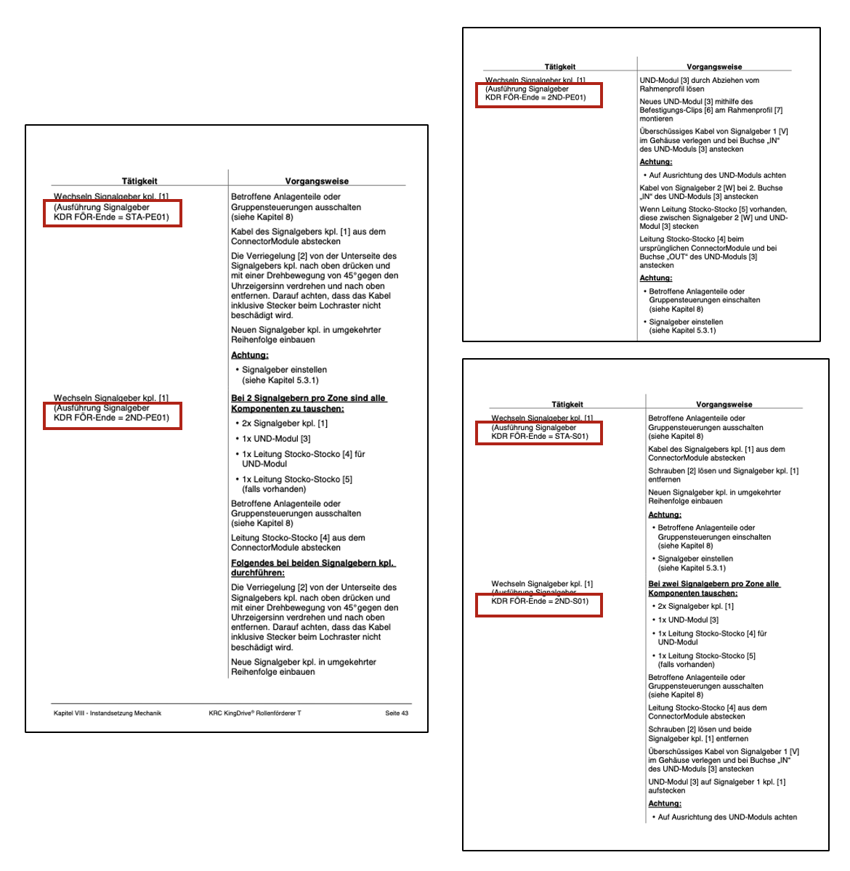
Similar components
04
Machine components are often present in multiple modifications.
Problem:
Standard RAG approaches are prone to mixing up similar components. → This might lead to harmful consequences (e.g. safety)
Moreover, if the user does not specify which component he refers to, the application should ask the user for clarification.
Test Query:
“Wie wechsele ich den Signalgeber?”

Slide 6
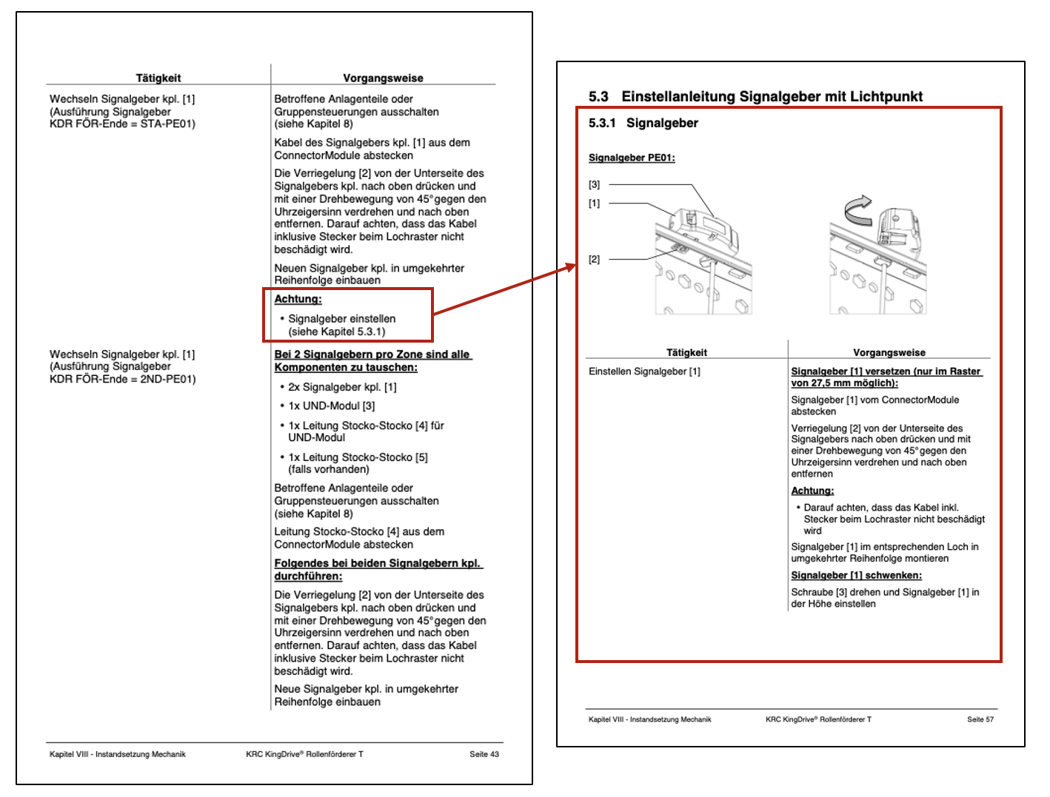
References
05
The content contains references to other parts of the documentation or other documentation.
Problem:
The LLM’s response might lack important information → This might lead to harmful consequences (eg. safety)
Test Query:
“Wie wechsele ich den Signalgeber STA-PE01?”

Slide 7

Benchmark Queries
Wie wechsele ich das Netzteil?
Wie wechsele ich eine KingDrive-Rolle?
Wie wechsele ich den Signalgeber?
Wie wechsele ich den Signalgeber STA-PE01?
The ground truth is an answer composed of the content visualised with the red boxes on the previous pages.

Slide 8


